Slide 1
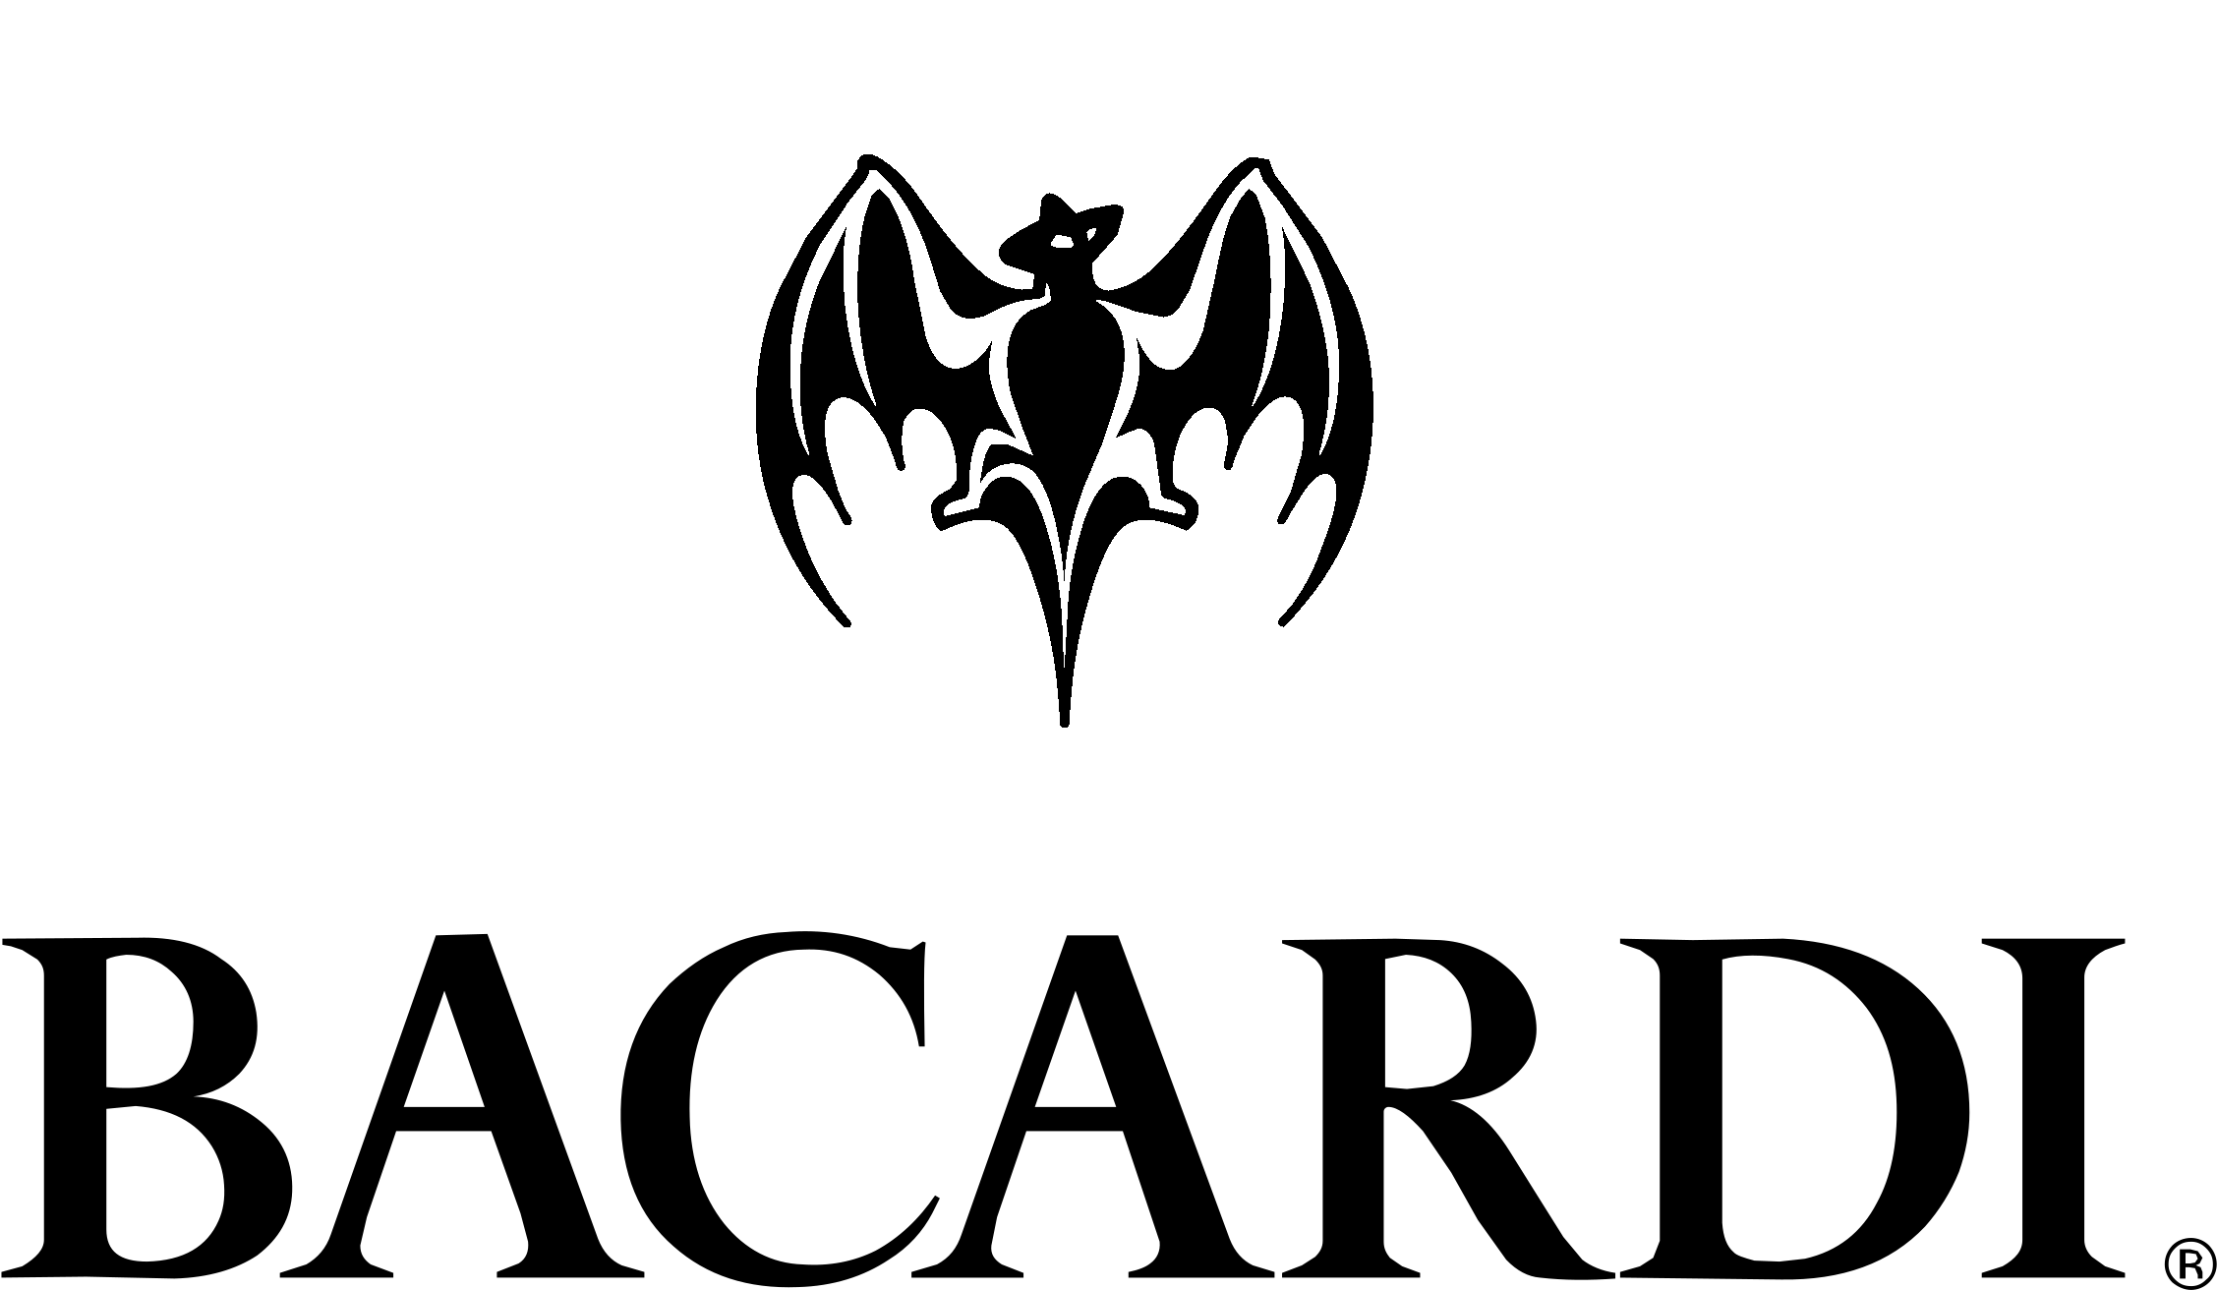
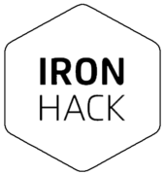
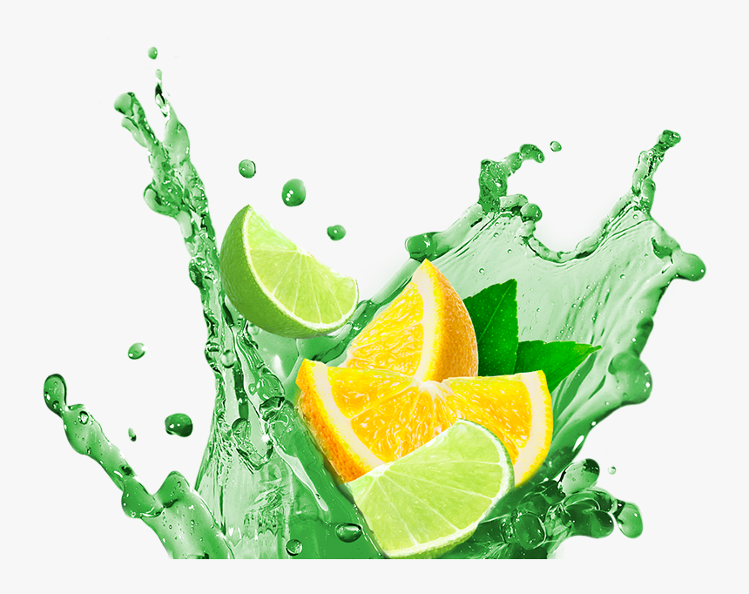
Cocktail / Mocktail flavor trends
Data Analytics Bootcamp Final Project
Cath Vos & Roger Serret
June 2022
Notes:
Hello everybody, I’m Roger and this is Cath and we are going to present you our Project about cocktail and mocktail trends

Slide 2
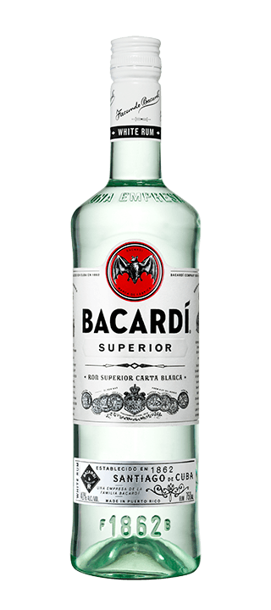
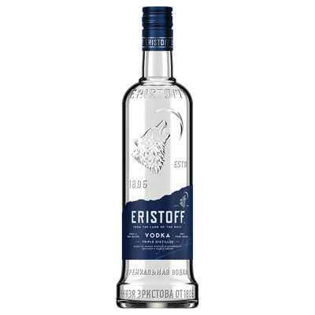
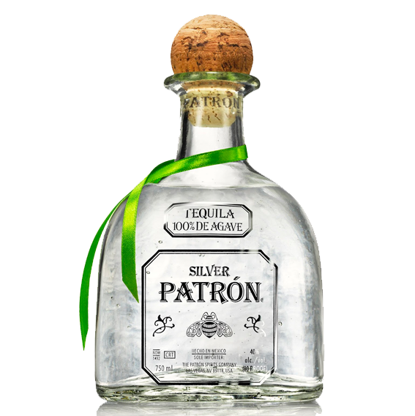
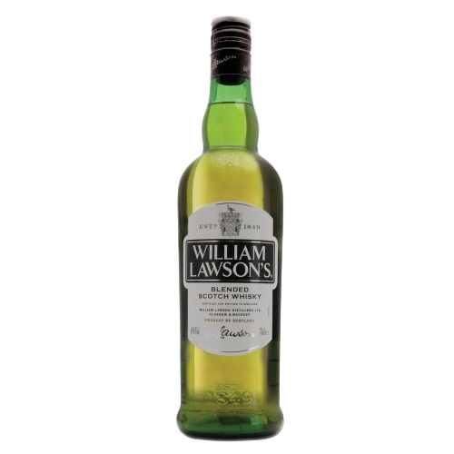
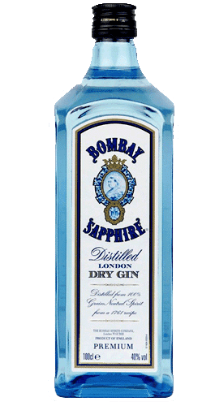
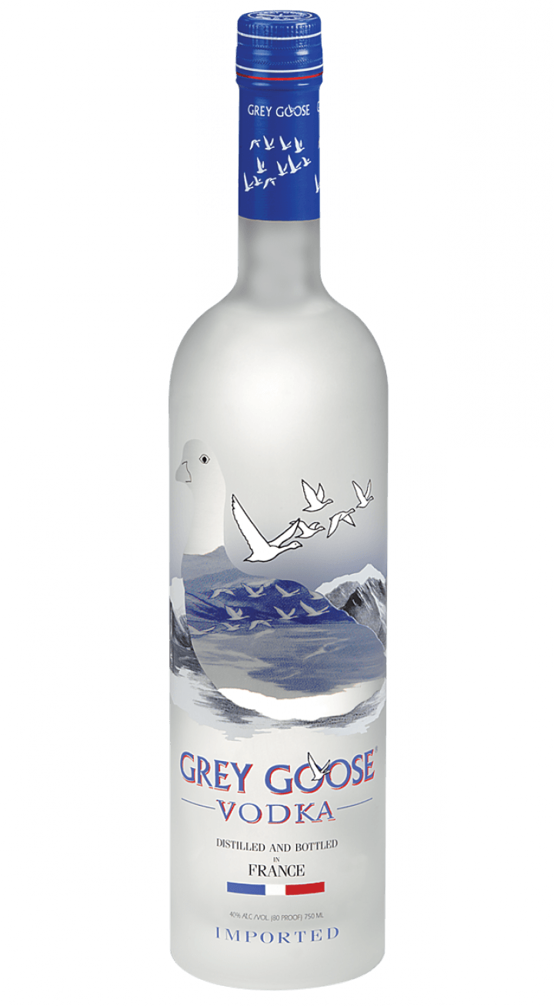
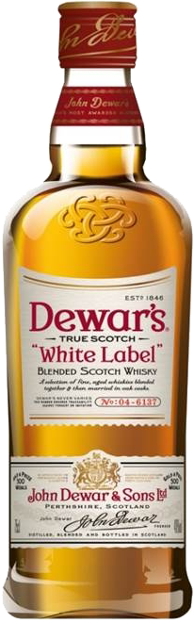
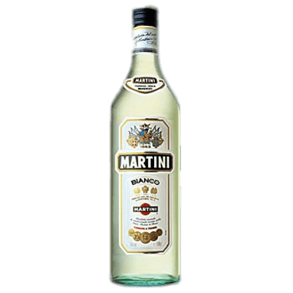
Agenda
Context
Trends
Goal
Challenge
Approach
Analysis
Recommendations
Wrap up
Notes:
First of all, we will put you in the context of the Project, so you can understand the company and the needs.
Then we Will talk about some market trends
We Will explain you the goal of the Project and our challenge
And we Will move to how we tackled this challenge and the approach we followed.
After that, we Will go through the main insights we got during our análisis
And we Will make some final recommendations and wrap up

Slide 3

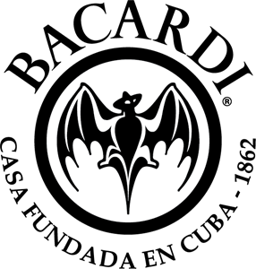

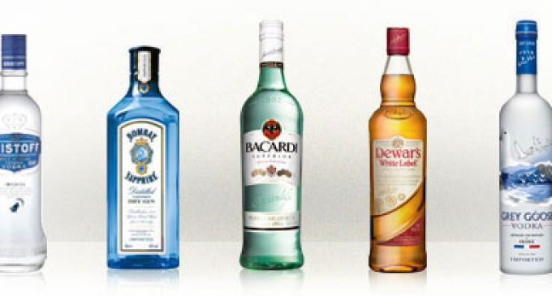
Context: Who are we?
+200
brands
+150
countries
Cath Vos
Data Analyst
Rotterdam
Roger Serret
Data Analyst
Barcelona
Rum
Sparkling wine
Vodka
Gin
Vermouth
Cognac
Whisky
Bourbon
Tequila
Cachaça
Liqueurs
Notes:
So let’s start!
As I told you, this is Cath Vos, from Rotterdam and I’m Roger Serret, from Barcelona and we are both data analysts working for Bacardi
But, what is Bacardi? You’ve probably Heard about their rum, but they are way more than that!
Bacardi owns more tan 200 brands and operates in +150 countries
And they are not only selling rum, but also other products like…. (list)

Slide 4

Context: Bacardi’s needs
Business growth
Internal data
Forecasting sales
Understanding customers better
Improving marketing campaigns
Improving logistics
External data
Bacardi needs to leverage the power of data to keep the leading position in the market.
Notes:
So, in order to keep being a leader in the market, Bacardi needs to get insights from data, internal but also external and market data.
Because that will allow them to keep making the business grow
How? By allowing them to forecast sales… (list)

Slide 5


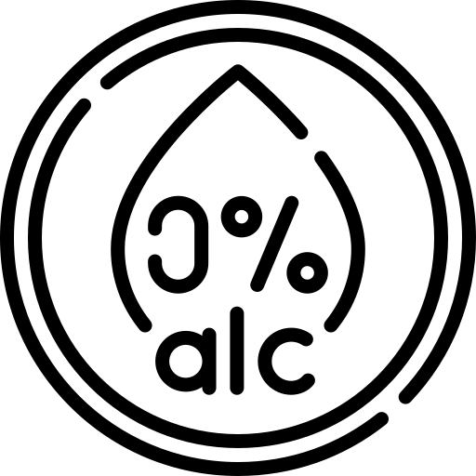

Context: Sustainability
Sustainability is a key branding element for Bacardi:
Positive environmental impact
Be inclusive
Responsible sourcing partnerships
Reduce alcohol-related harm
Notes:
Another important think about Bacardi is that it is already a sustainable company, but they want to keep improving their sustainability as one of their main business goals
Sustainability is sth that personally motivates us a lot, and that’s why we wanted to focus our project on one of their sustainability goals.
Reducing the alcohol-related harm.

Slide 6
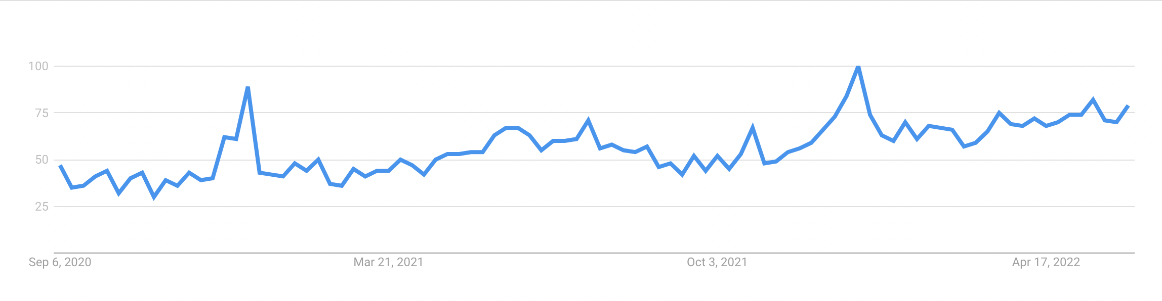
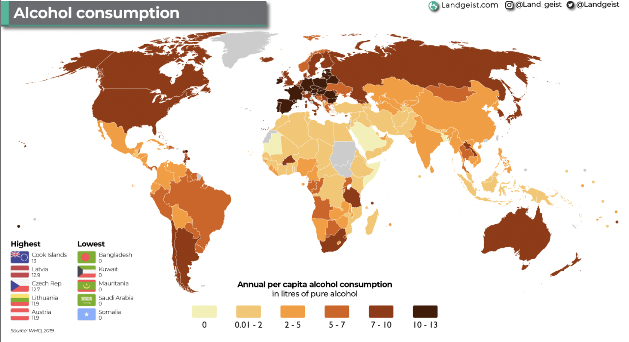
Trends: NOLO drinks
Huge potential non-alcoholic market in the world.
Worldwide alcohol consumption in 2019.
Source: ourworldindata.org
“Mocktail” trendline in Google Trends.
Non-alcoholic cocktails are a real trend that Bacardi should leverage.
Notes:
We did some research on that topic and we discovered that non-alcoholic and low-alcohol drinks were a real trend.
As you can see in the plots, there is huge potential… and in Google trends, mocktail is raising a lot during the last years.
Thus, we decided to analyze cocktail recipes data to check if that trend was going to impact this sector.

Slide 7

Goal: Our project
Infer the spirits, fruits, and condiments that will define the next NOLO drink hit and validate the existence of the NOLO trend.
Notes:
So, the goal of our Project is to…

Slide 8


Challenge: Flavor trends
Map out the flavors that were mentioned the most during the past 10 years in webs, blogs and social media.
Notes:
And to reach that goal our challenge was to map out…

Slide 9
APPROACH
Notes:
Cath Will explain you how we approached it.

Slide 10
Approach: Web scraping & Analysis
Web scraping/API:

Slide 11
Approach: Web scraping & Analysis
Web scraping/API:
Instagram
Tales_of_the_cocktail
Recette_cocktail
Join_jules
Simplycocktail
Twice_element
Cocktailrecipeclub

Slide 12
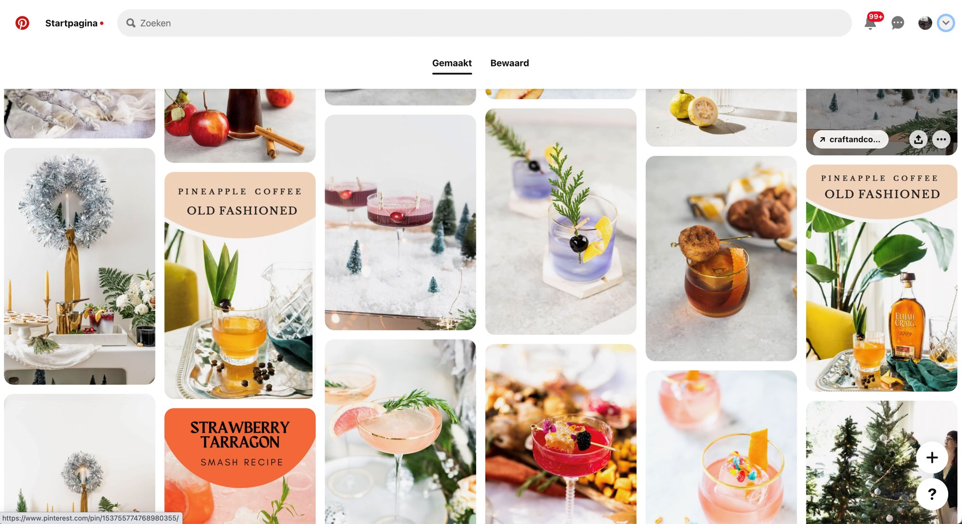
Approach: Web scraping & Analysis
Web scraping/API:
Instagram
Pinterest

Slide 13
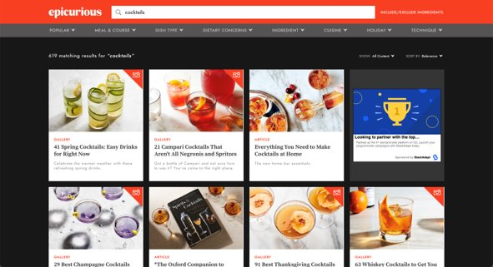
Approach: Web scraping & Analysis
Web scraping/API:
Instagram
Pinterest
Websites

Slide 14
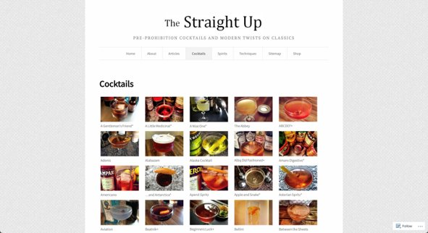
Approach: Web scraping & Analysis
Web scraping/API:
Instagram
Pinterest
Websites

Slide 15
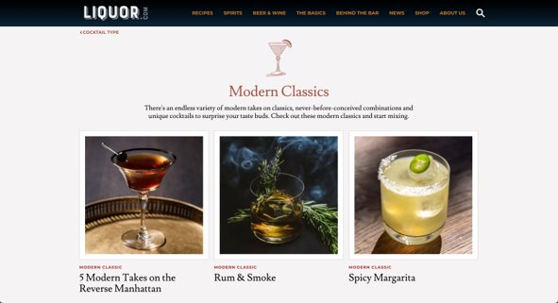
Approach: Web scraping & Analysis
Web scraping/API:
Instagram
Pinterest
Websites

Slide 16
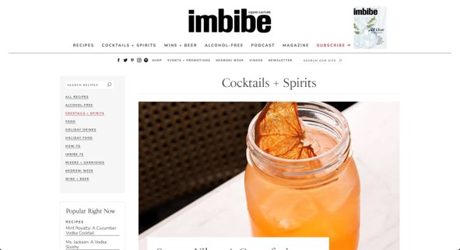
Approach: Web scraping & Analysis
Web scraping/API:
Instagram
Pinterest
Websites

Slide 17
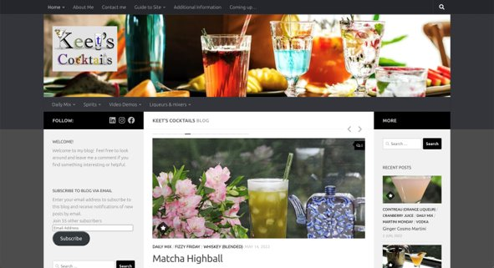
Approach: Web scraping & Analysis
Web scraping/API:
Instagram
Pinterest
Websites
Blogs

Slide 18
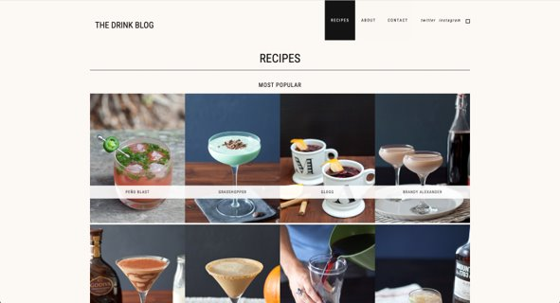
Approach: Web scraping & Analysis
Web scraping/API:
Instagram
Pinterest
Websites
Blogs

Slide 19

Approach: Web scraping & Analysis
Web scraping:
Instagram
Pinterest
Websites
Blogs
Kaggle

Slide 20
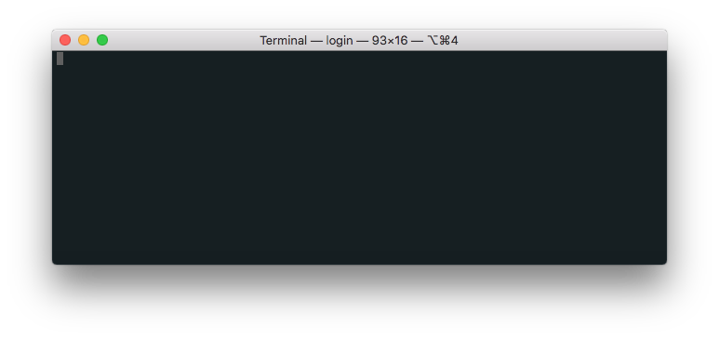
Approach: Web scraping & Analysis
Web scraping/API:
Instagram
Pinterest
Websites
Blogs
Kaggle
Condiments=['mint', 'basil', 'cardamon', 'cinnamon', 'coriander', 'ginger', 'lavender', 'rosemary', 'eucalyptus', 'lemongrass', 'tarragon', 'vanilla', 'chamomile', 'cocoa', 'milk', 'sparkling water', 'cucumber', 'chilli', 'syrup', 'coffee', 'bitters', 'cream', 'lemonade']
Fruits=['lemon', 'banana', 'lime', 'pear', 'mandarin', 'citrus', 'watermelon', 'peach', 'pineapple', 'orange', 'cranberry', 'strawberry', 'blackberry', 'raspberry', 'blueberry', 'mango', 'papaya', 'apple', 'passion fruit', 'apricot', 'maracuya', 'cherry', 'kiwi', 'plum', 'grapes', 'fig', 'grapefruit',
'pomegranate', 'coconut', 'pumpkin']
spirits=['sparkling wine', 'champagne', 'prosecco', 'rum', 'vodka', 'gin', 'vermouth', 'cognac', 'whisky', 'whiskey', 'bourbon', 'tequila', 'cachaça', 'liqueurs', 'mezcal']
Creating clean, full data frame

Slide 21
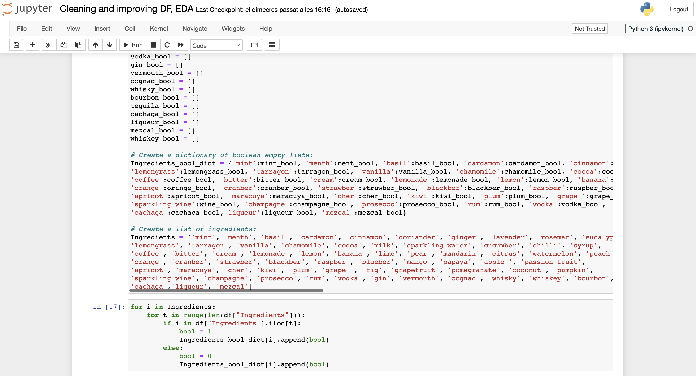
Approach: Web scraping & Analysis
Web scraping/API:
Instagram
Pinterest
Websites
Blogs
Kaggle
Creating clean, full data frame

Slide 22

Approach: Web scraping & Analysis
Web scraping/API:
Instagram
Pinterest
Websites
Blogs
Kaggle
Creating clean, full data frame
EDA & Analysis

Slide 23
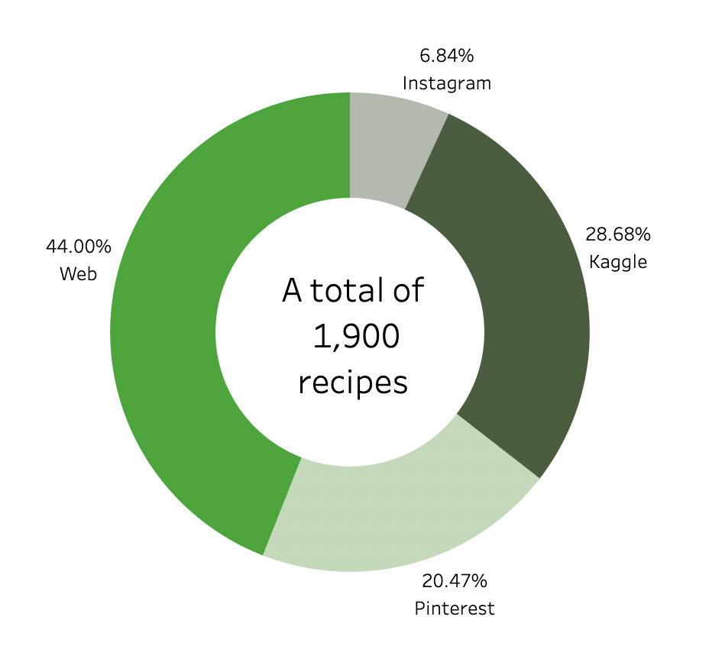
Approach: Data origin

Slide 24
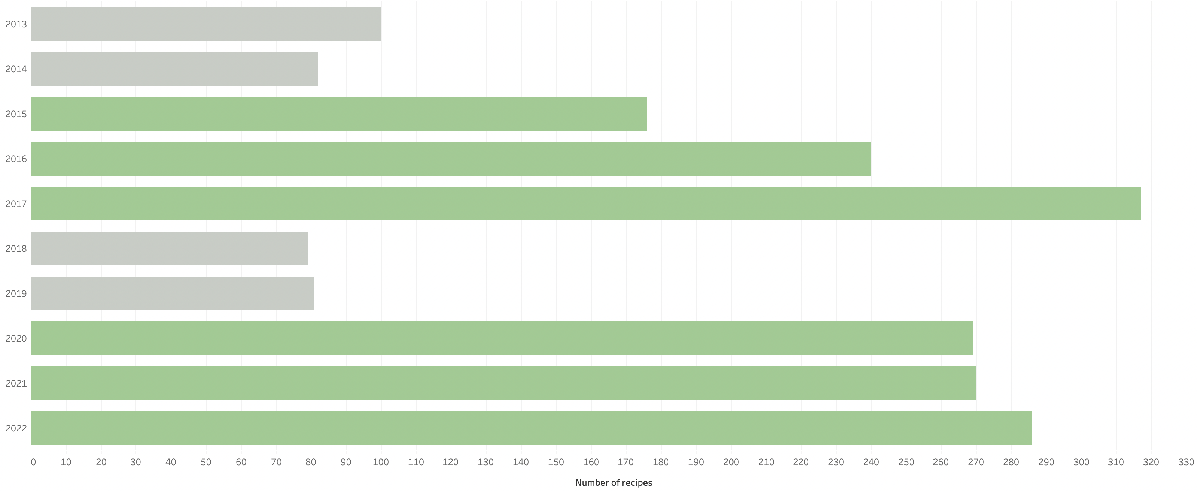
Approach: Data origin

Slide 25



Approach: Out of scope
For next project iteration:
Tik tok
Spirit
influencers
Seasonality

Slide 26
ANALYSIS
Notes:
Going now to the most interesting part of the Project. What insights did we find from all the analysis?

Slide 27
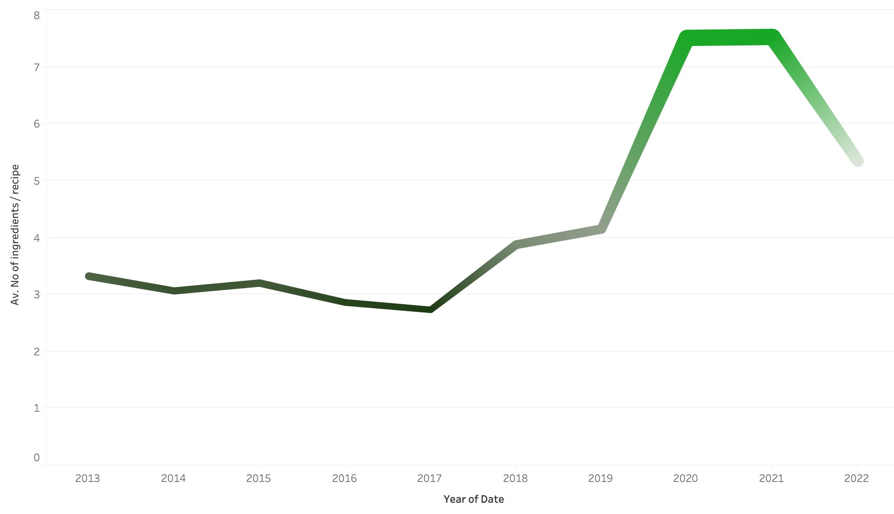
Analysis: Insights
Notes:
First thing we checked was the number of ingredients per cocktail recipe and we saw something interesting.
Last years cocktails have gain complexity, but now they seem to be back to simplicity.

Slide 28
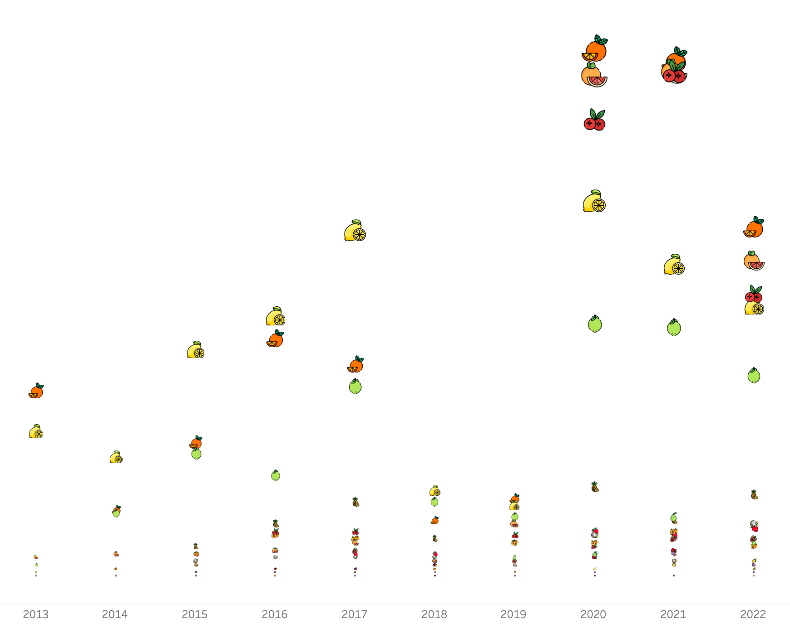
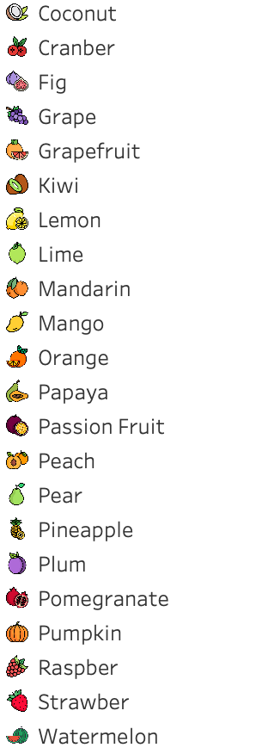
Analysis: Insights
#fruits
Notes:
Then we moved straight to check which were the most trendy fruits.
We can see here that during last years Orange, grapefruit and cranberries are at the top and other common fruits like lemon have been overcome by them.

Slide 29
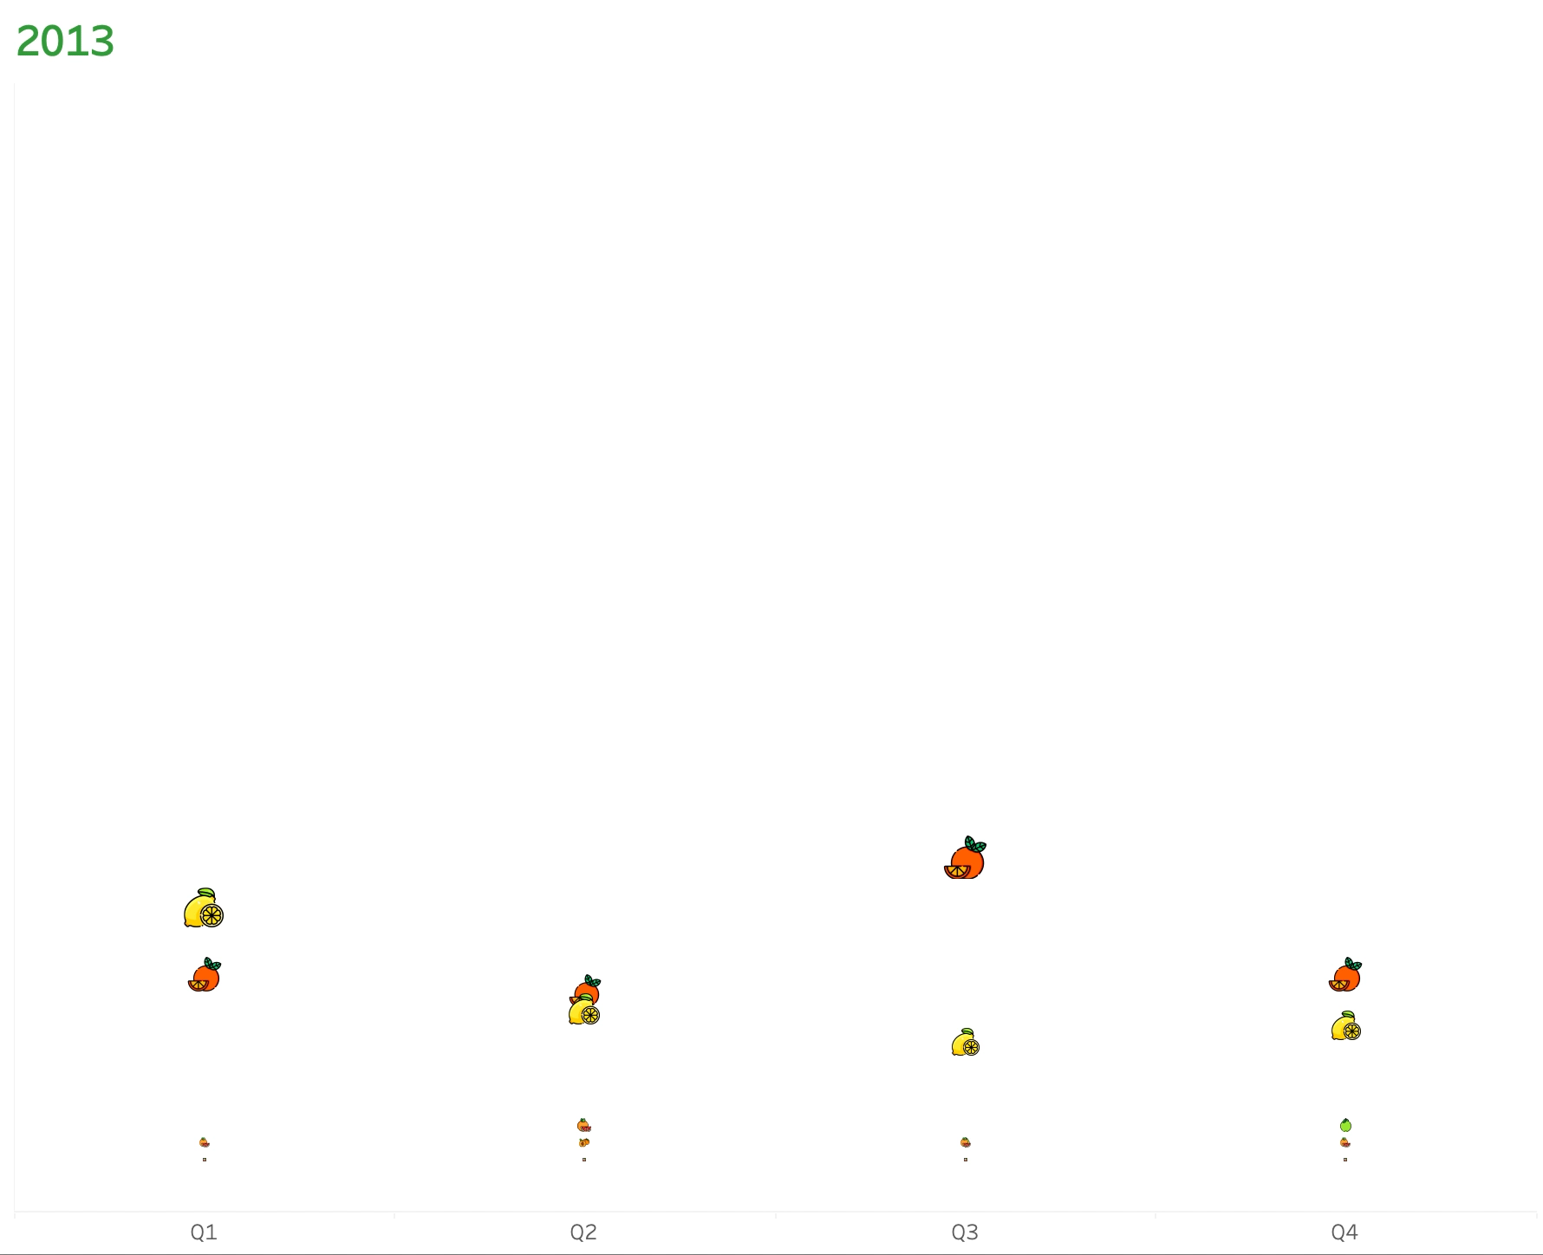
Analysis: Insights
#fruits
Notes:
In this animated plot we can se the evolution of the fruits year by year. You can see the year at the top left corner.

Slide 30
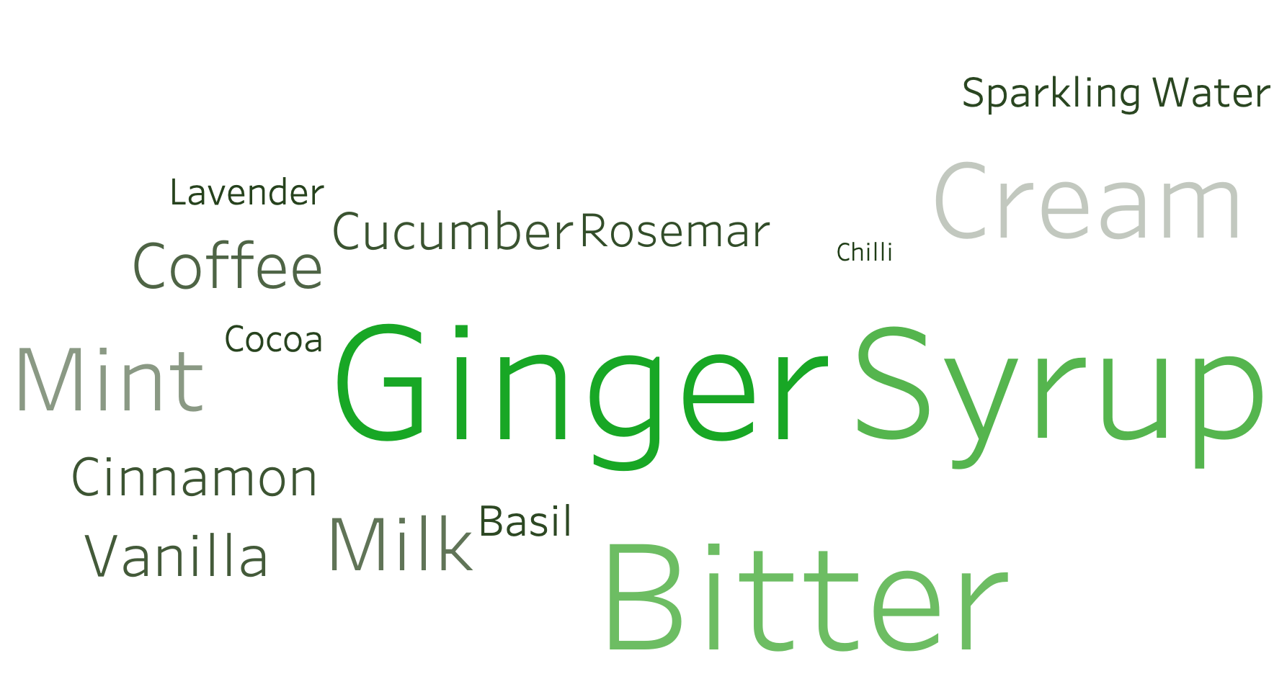
Analysis: Insights
#condiments
Notes:
Now we are moving to the condiments.
This is a text plot were the greener and the bigger are the most trendy condiments
Ginger, syrup, bitters, cream, coffee and mint are some of the most popular nowadays

Slide 31
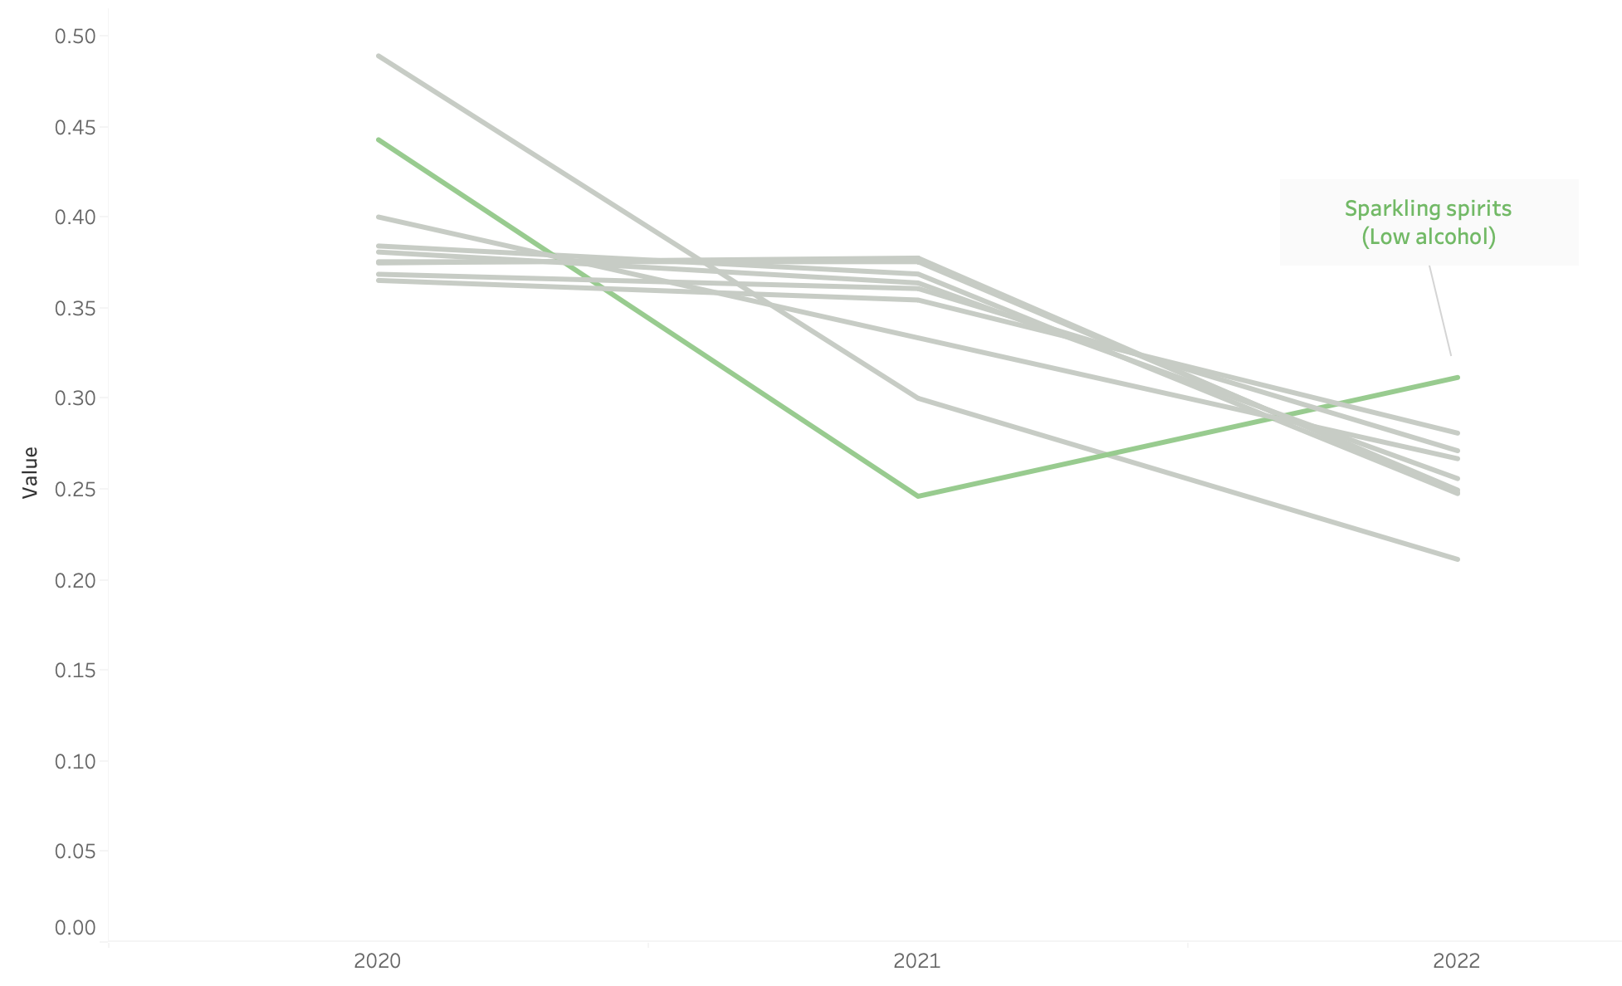
Analysis: Insights
#spirits
Notes:
And finally, we also analyzed the spirits.
This plot is a clear validation of the NOLO trend. It shows the percentage of recipes that contain the different spirits.
Clear decreasing trend in alcohol in cocktails (the only one going a bit up is sparkling spirits, which are low in alcohol).
Non-alcoholic cocktails are raising a lot!

Slide 32
RECOMMENDATIONS
Notes:
So Cath, can you explain our final recommendations based on these insights?

Slide 33
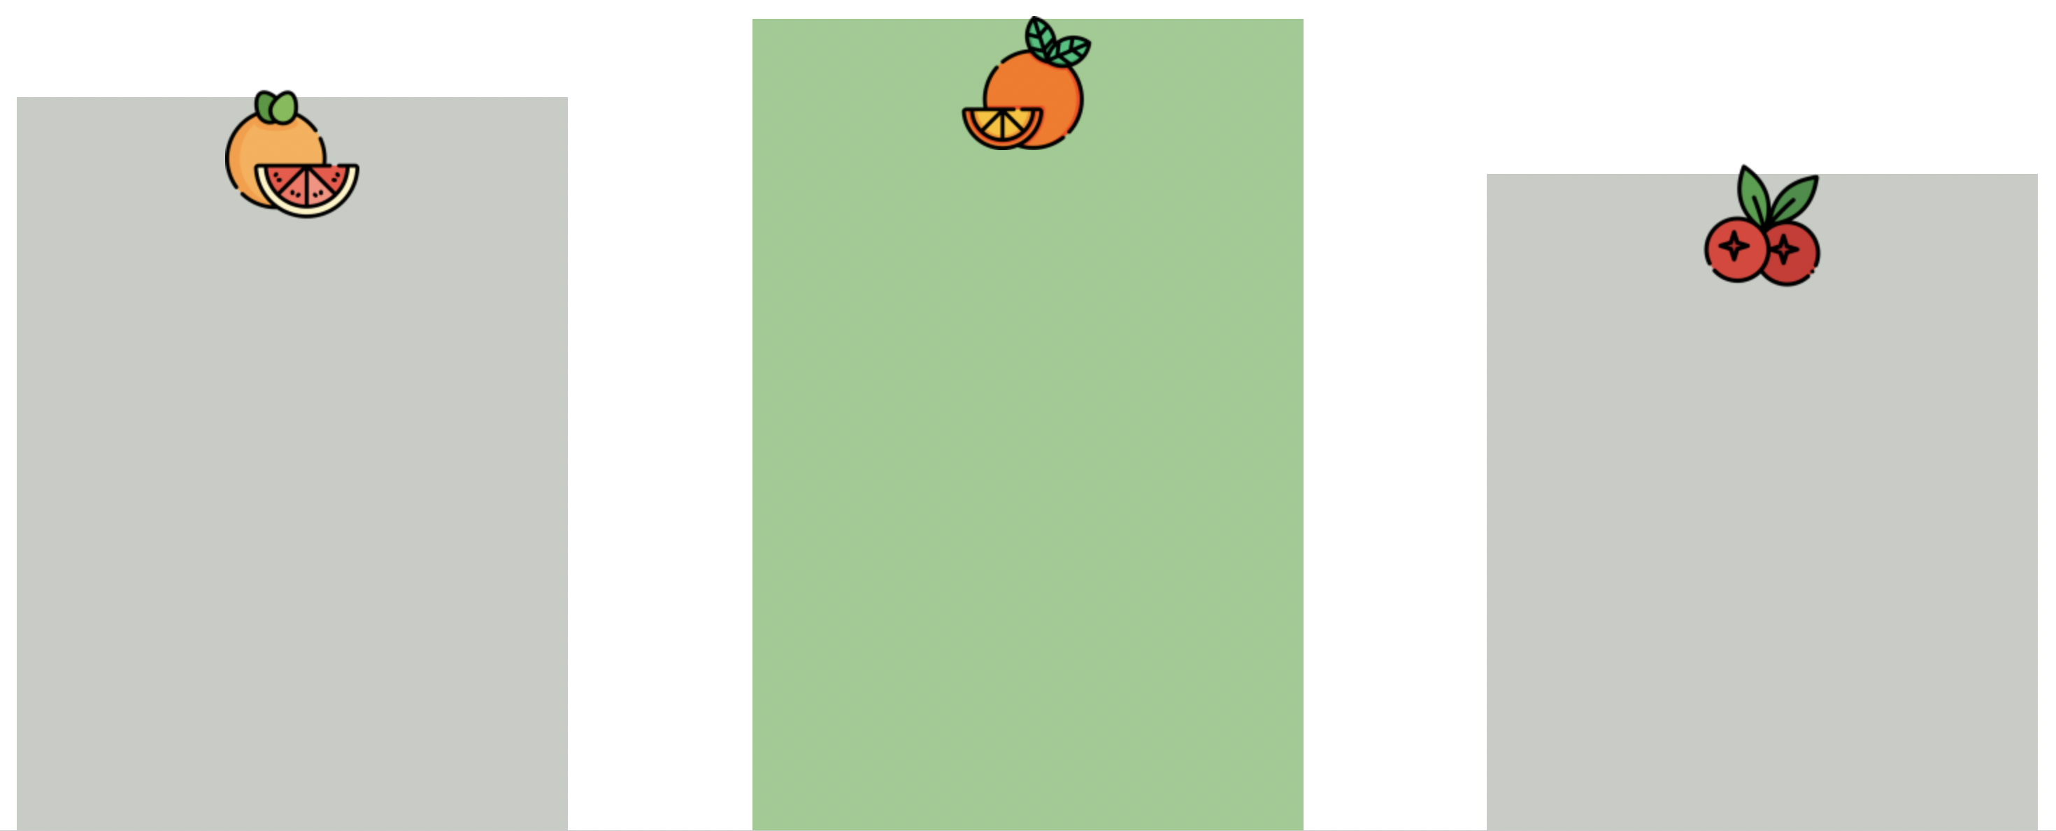
Recommendations: TOP fruits
Grapefruit
Orange
Cranberry

Slide 34
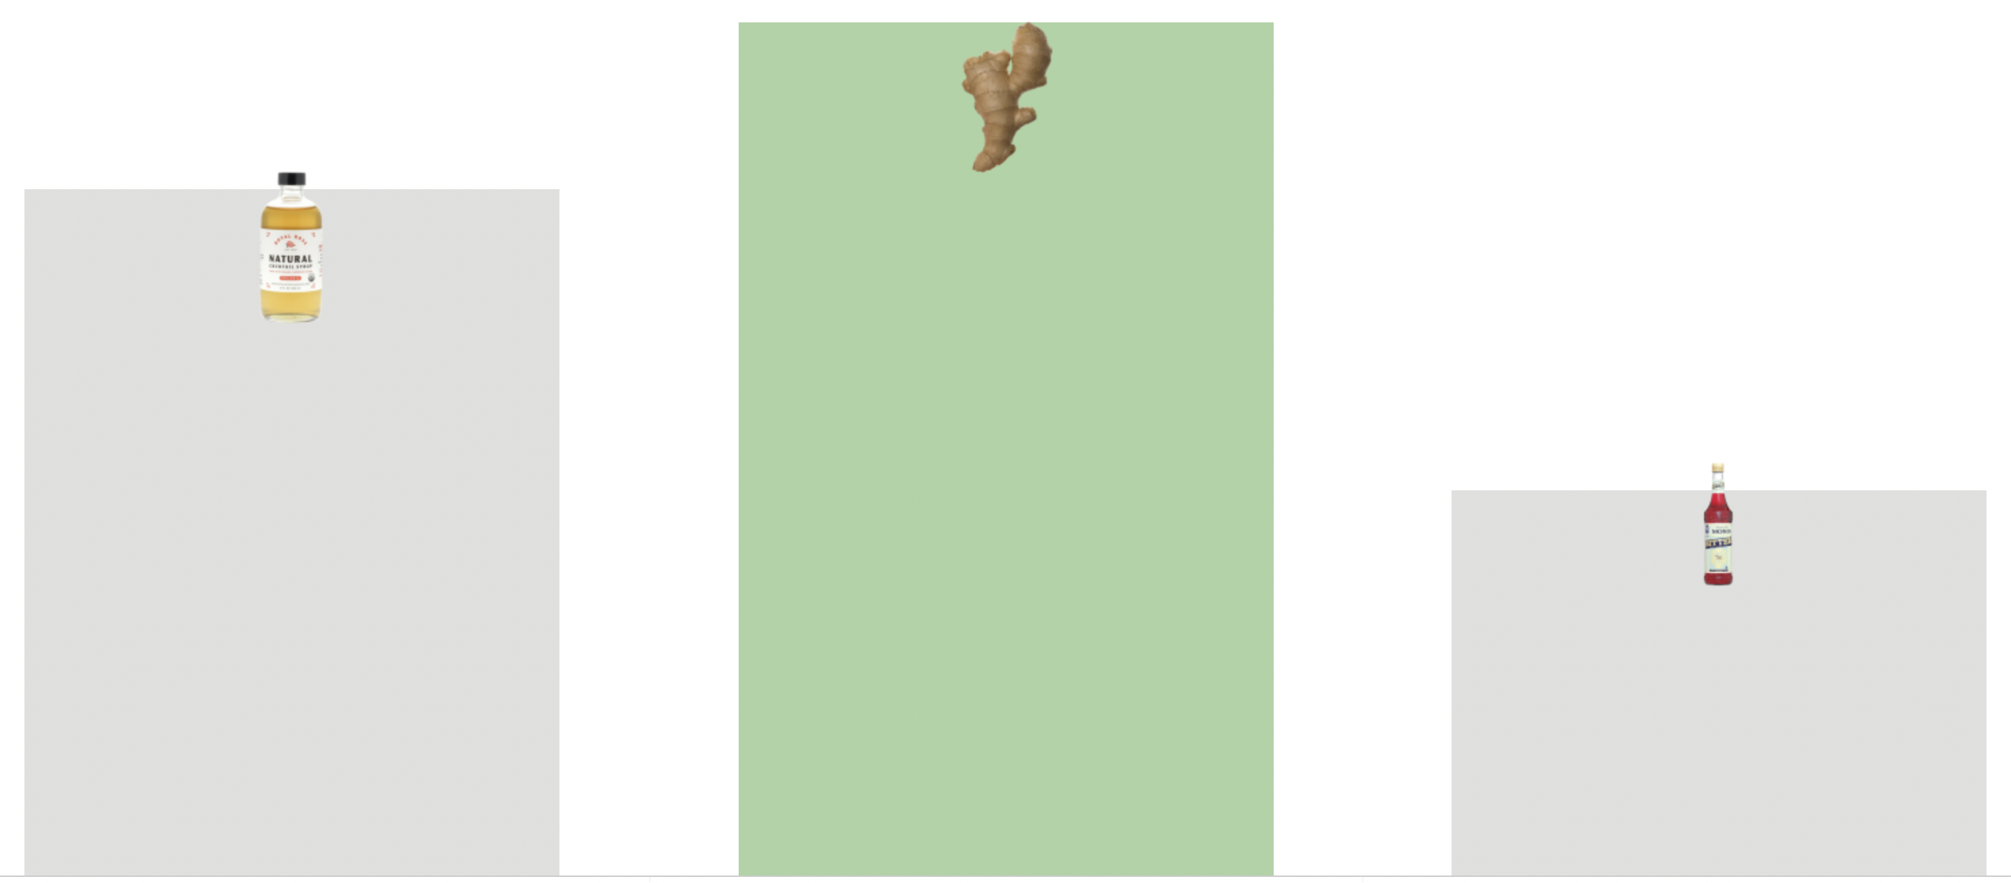
Recommendations: TOP condiments
Syrups
Ginger
Bitters

Slide 35
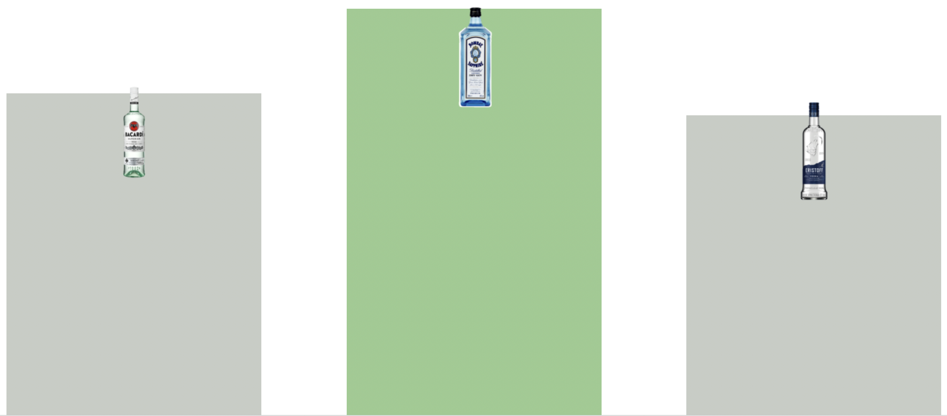
Recommendations: TOP spirits
Rum
Gin
Vodka

Slide 36
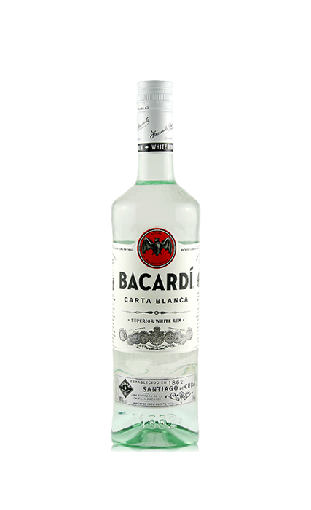
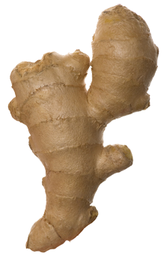
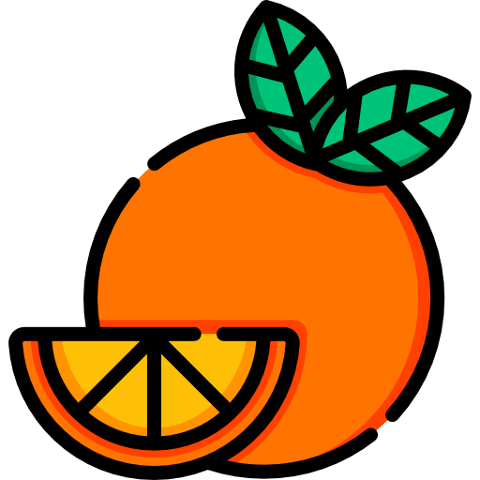
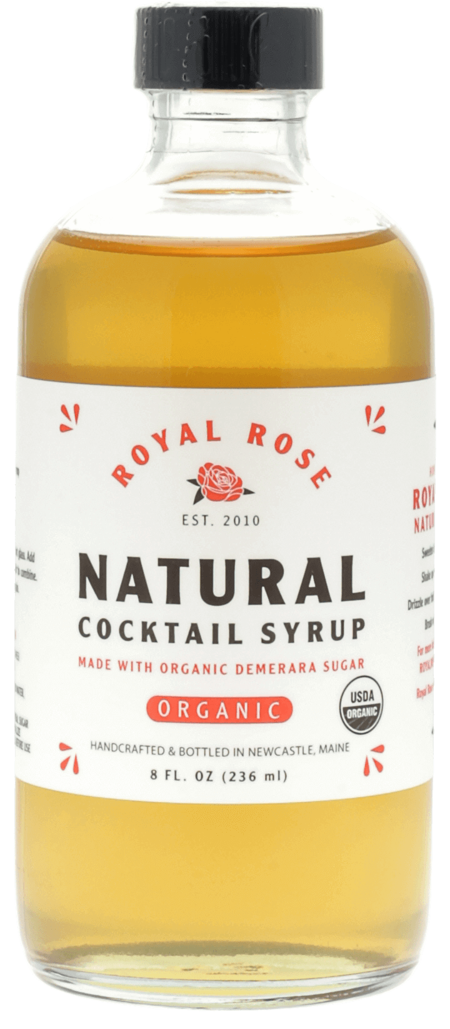
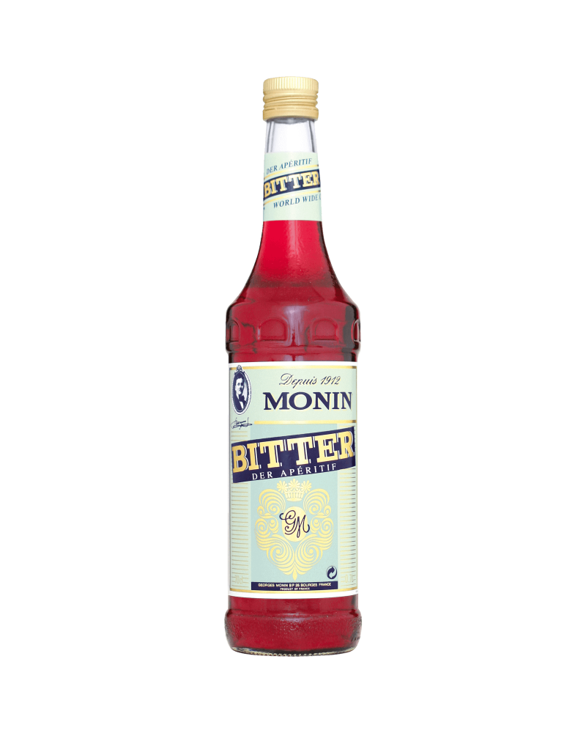
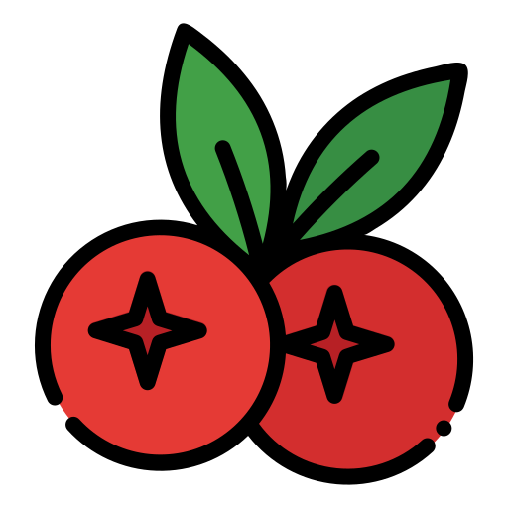
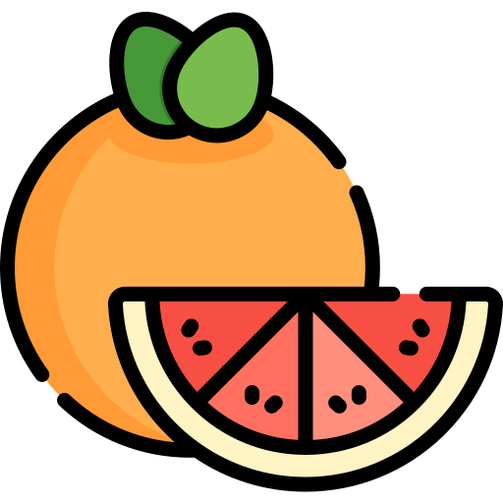

Wrap up: Final recap

Slide 37
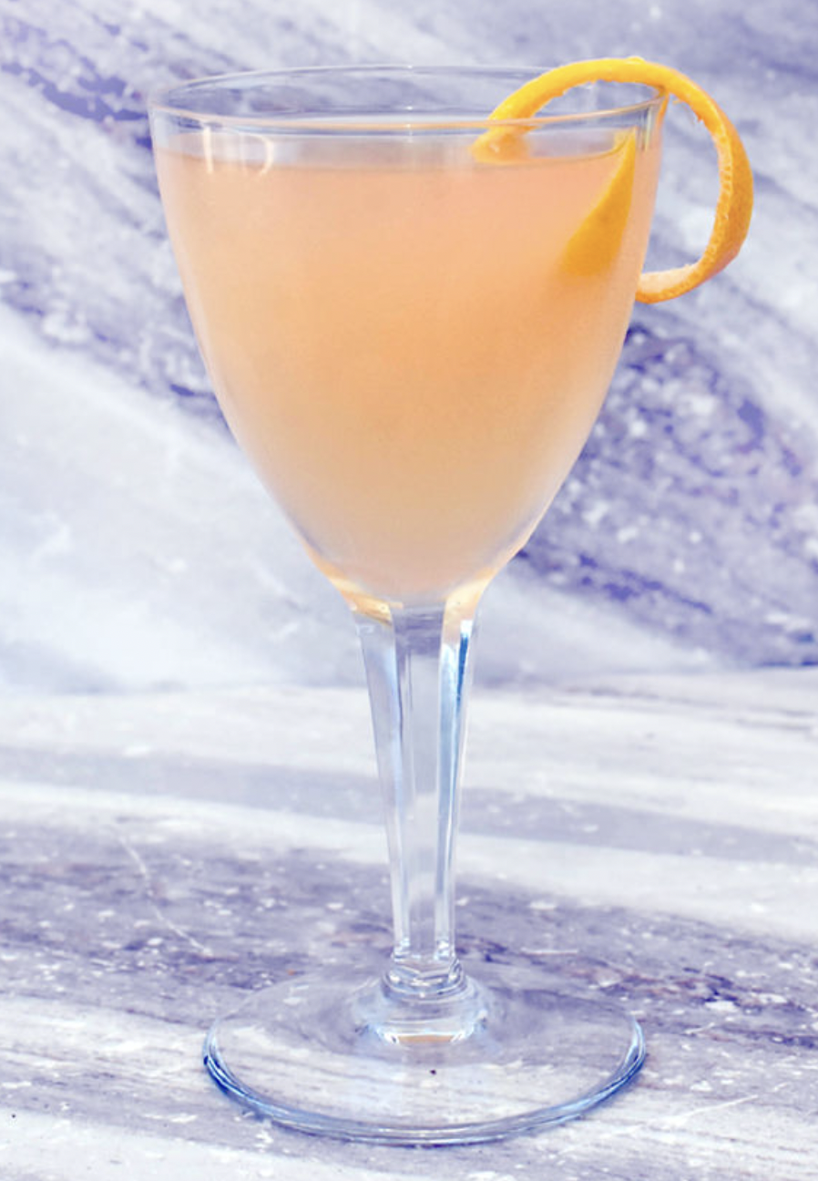
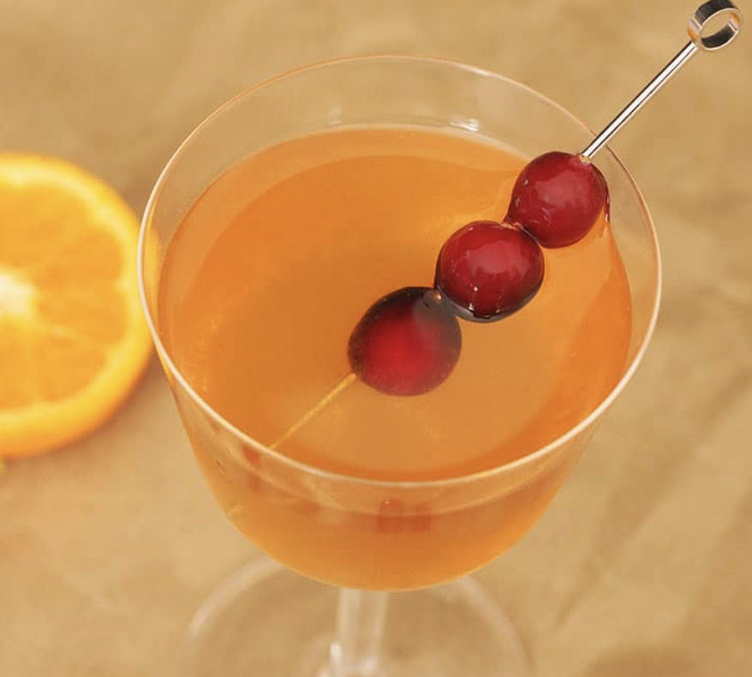
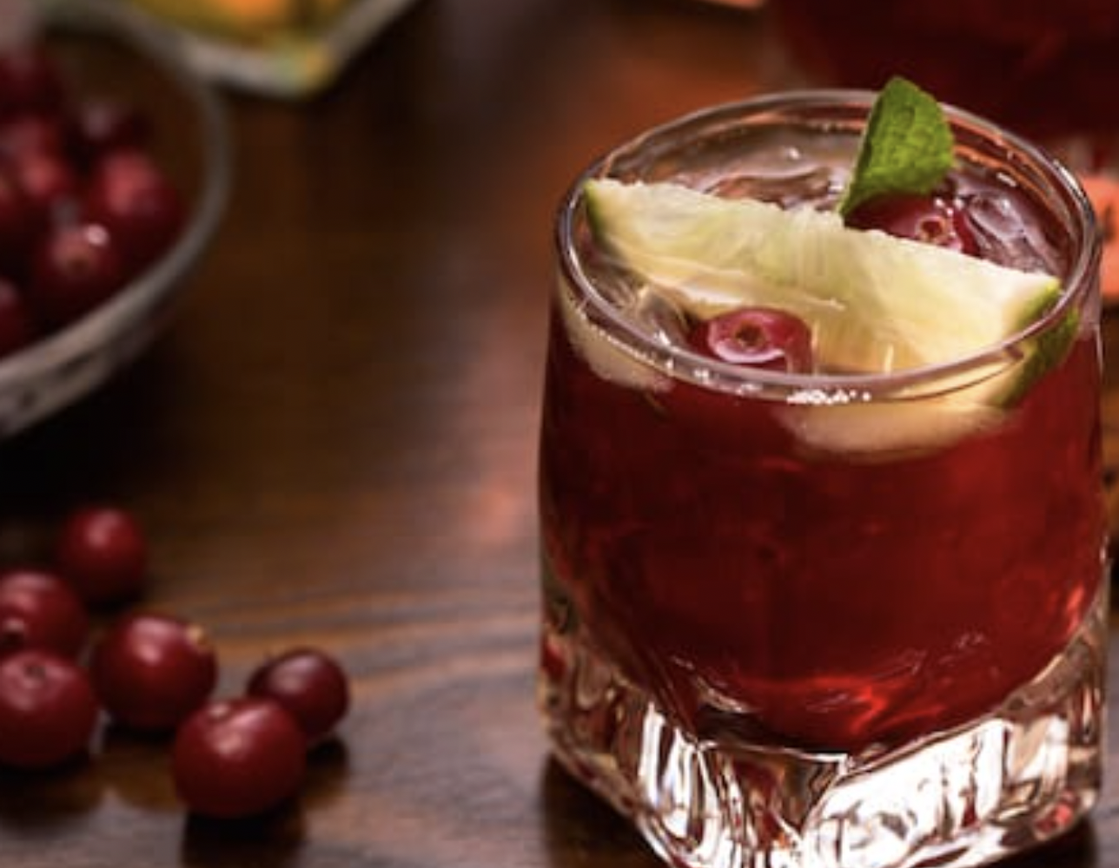
OUR BARTENDER’S INSPIRATION
The top cocktail
Alcohol-free gin
Orange, ginger
Refreshing
Slightly sweet
Fun and fruity
The red mocktail
Fresh lime
Cranberry
Dashes of Angostura bitters
Grapefruit Daiquiri
White alcohol-free rum
Agave syrup
Lime juice

Slide 38

Any questions?

